Slide 1




NEXT GEN EMPLOYABILITY PROGRAM
Creating a future-ready workforce
Team Members
College Name
Student Name : Althaf. M
Student ID : au513521243002
5135-Annai Mira College of engineering and technology,
Ranipet

Slide 2

CAPSTONE PROJECT SHOWCASE
Project Title
Building Bus Reservation System using Python and Django
Abstract | Problem Statement | Project Overview | Proposed Solution | Technology Used | Modelling & Results | Conclusion

Slide 3
Abstract
Traveling is a large growing business across all countries. Bus reservation system deals with maintenance of records of details of each passenger. It also includes maintenance of information like schedule and details of each bus.
We observed the working of the Bus reservation system and after going through it, we get to know that there are many operations, which they have to do manually.
It takes a lot of time and causing many errors while data entry. Due to this, sometimes a lot of problems occur and they were facing many disputes with customers.
To solve the above problem, and further maintaining records of passenger details, seat availability, price per seat, bill generation and other things, we are offering this proposal of computerized reservation system.
By using this software, we can reserve tickets from any part of the world, through telephone lines, via internet. Customer can check availability of bus and reserve selective seats.
The project provides and checks all sorts of constraints so that user does give only useful data and thus validation is done in an effective way.
Source :

Slide 4
Problem Statement
The System that is being used by the staff at the counter currently is an internal system and just used to sell the bus ticket at the counter.
Customer has to go to the counter to buy bus ticket or ask for bus schedule. Furthermore, customers need to pay cash when they buy the bus ticket and sometimes needs to queue up long time to get the bus ticket.
Besides that, customer also not allowed to buy bus ticket through telephone and the bus company's telephone has been always- busy line.
Source :

Slide 5
Project Overview
The existing bus ticketing process is plagued by inefficiencies such as manual ticketing, limited seat availability visibility, and cumbersome payment procedures. Passengers often face challenges in securing tickets, especially during peak travel seasons.
Additionally, bus operators struggle to manage bookings and optimize seat utilization efficiently.
These issues result in dissatisfied customers and lost revenue opportunities for bus companies.
Source :

Slide 6
Proposed Solution
.
The solution to this problem is to create an online portal for buying bus ticket system.
Customer Can buy the bus ticket over the Internet, 24 hours a day, 7 Days a week and the bus ticket can't be lost, stolen or left behind.
In addition, the online system lets the customers check the availability of the bus ticket before they buy bus ticket.
OBJECTIVES :
The main objectives of the online system include:
To provide a web-based bus ticket buying functions. Customer can buy bus ticket throughthe online system and no need to queue up to buy bus ticket at the counter.
To enable customer to check the availability of the bus ticket online. Customer can check the time departure and arrival for every Transnational’s bus through the system.
To ease the bus ticket payment by online. Customer has to pay the bus ticket by money services
To reduce the number of staff at the point of sale. The number of staff at the counter can be reduced after the online buying bus ticket system launch
Source :

Slide 7


Technology Used
Front-end
Back-end
Source :

Slide 8
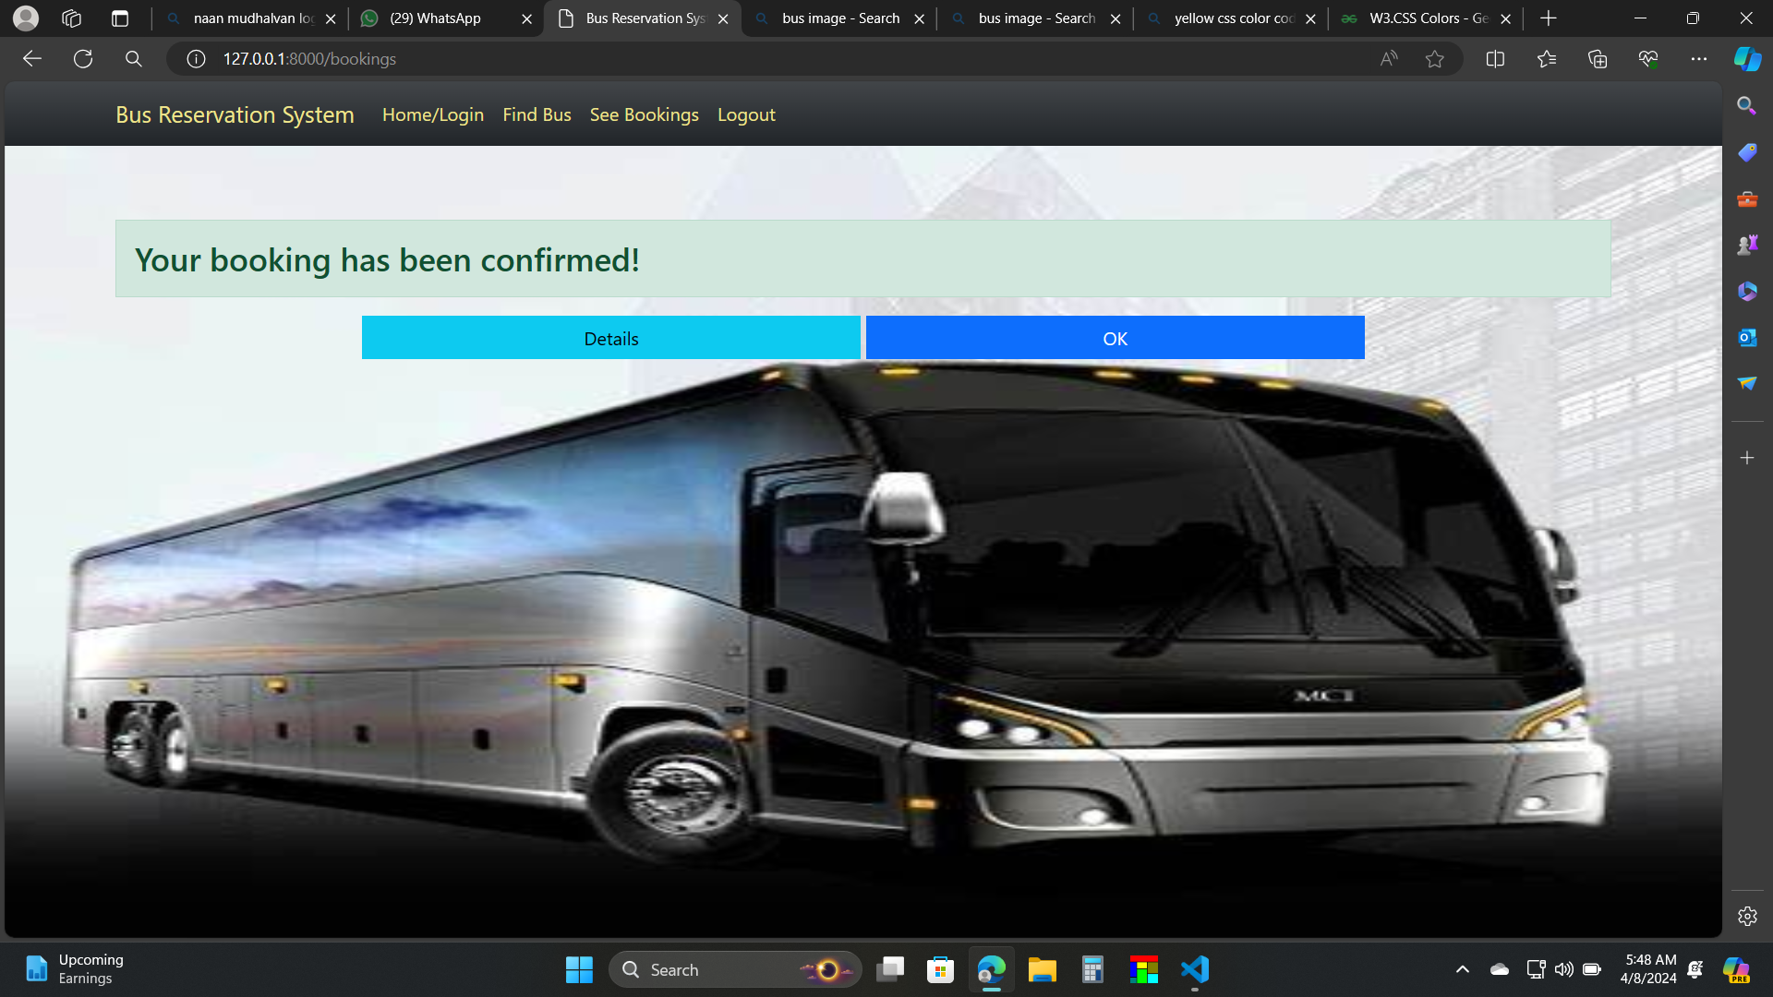
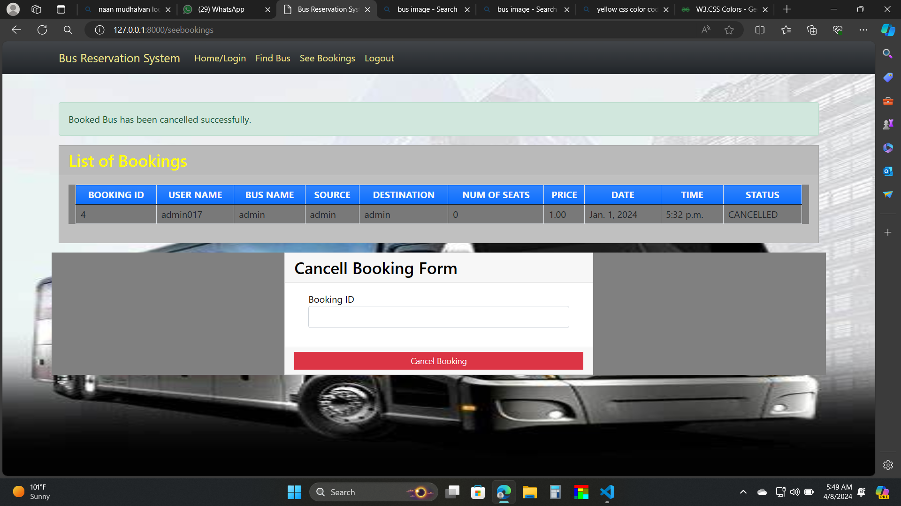
Modelling & Results
Source :

Slide 9
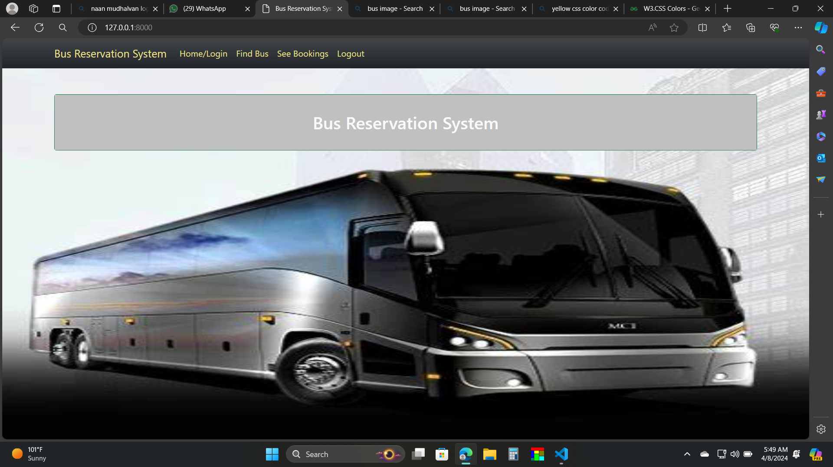
Homepage

Slide 10
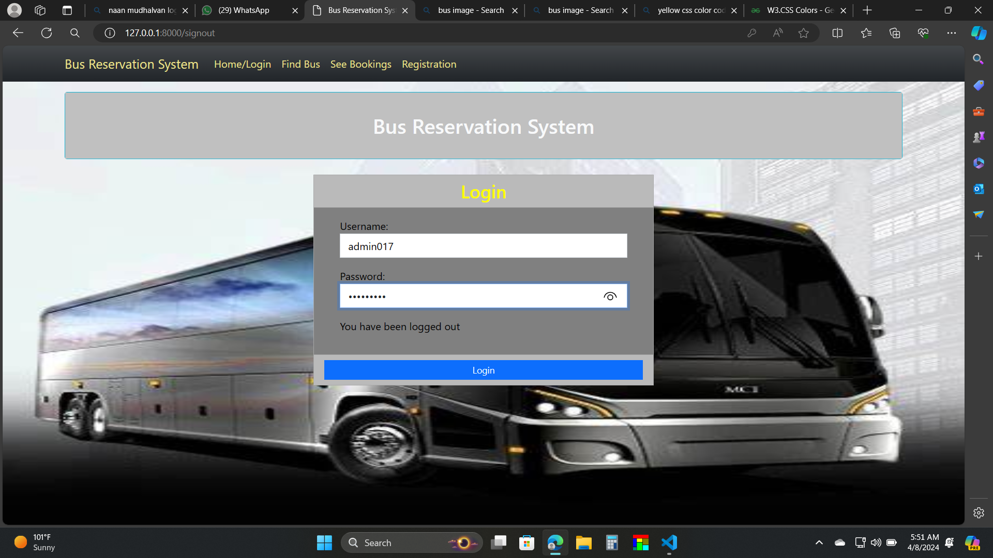
login

Slide 11
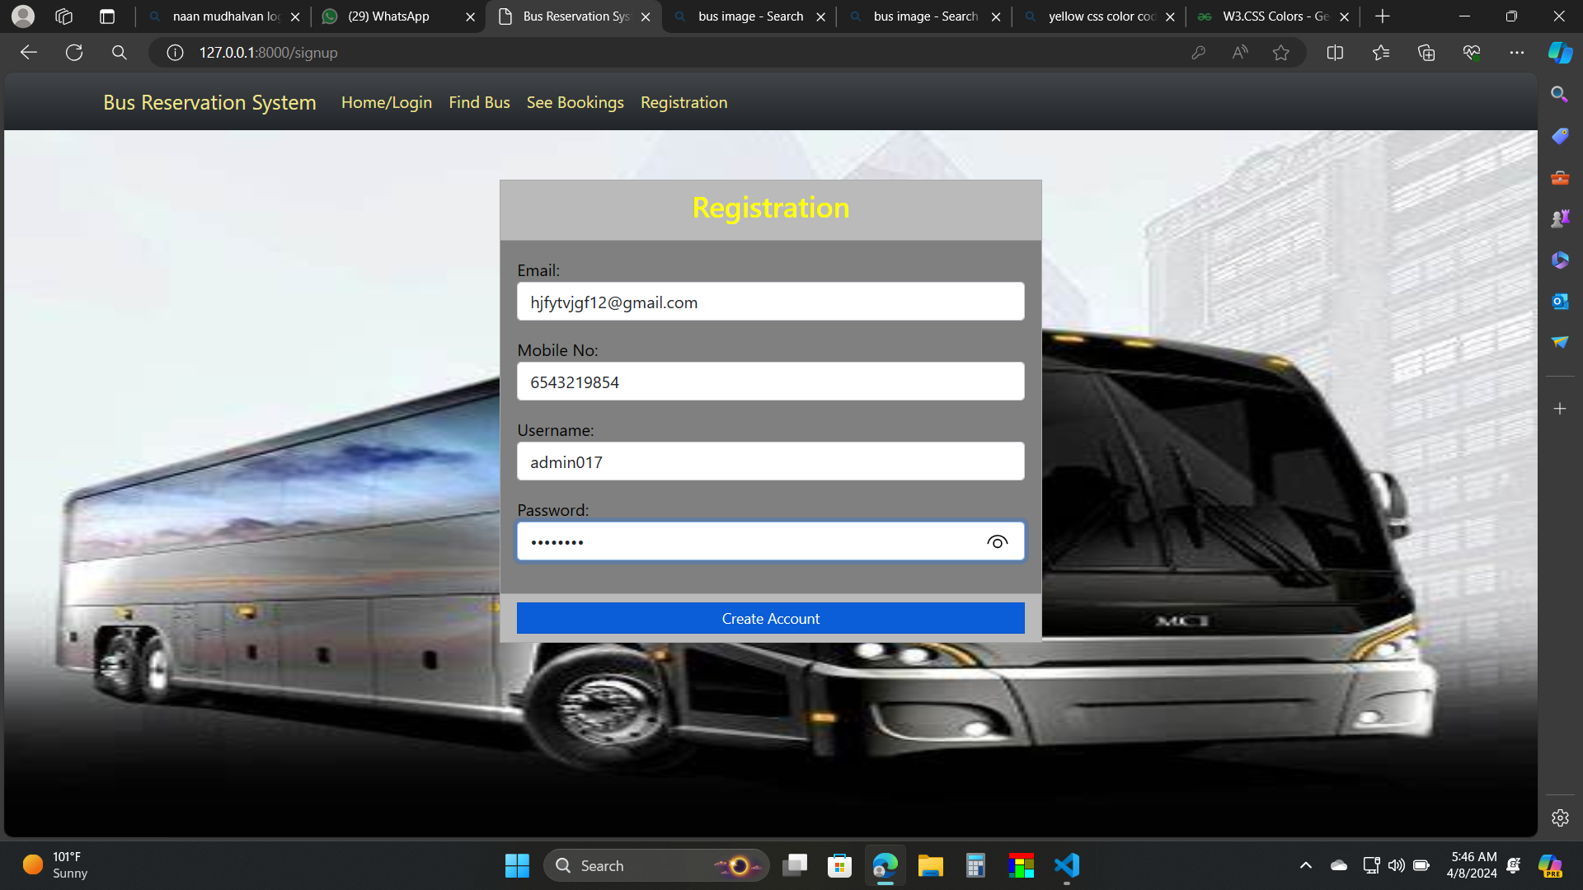
Registration

Slide 12
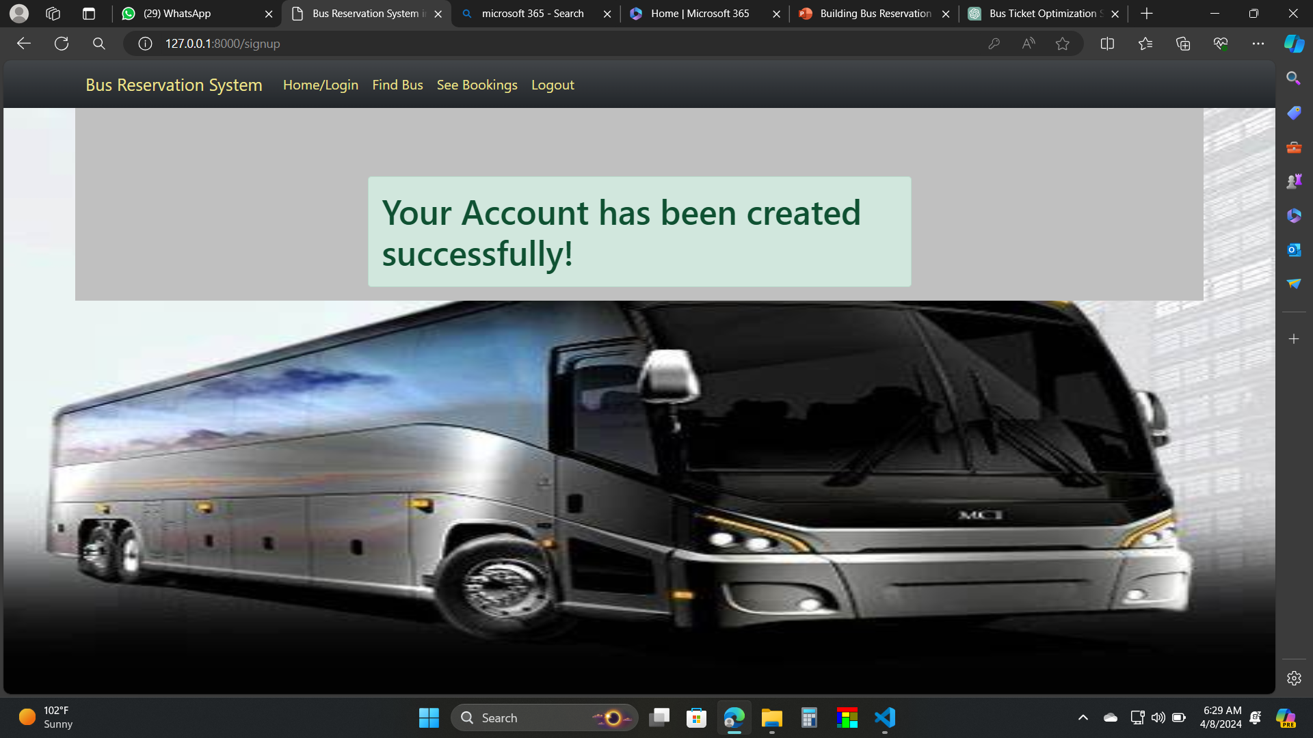
Account created

Slide 13
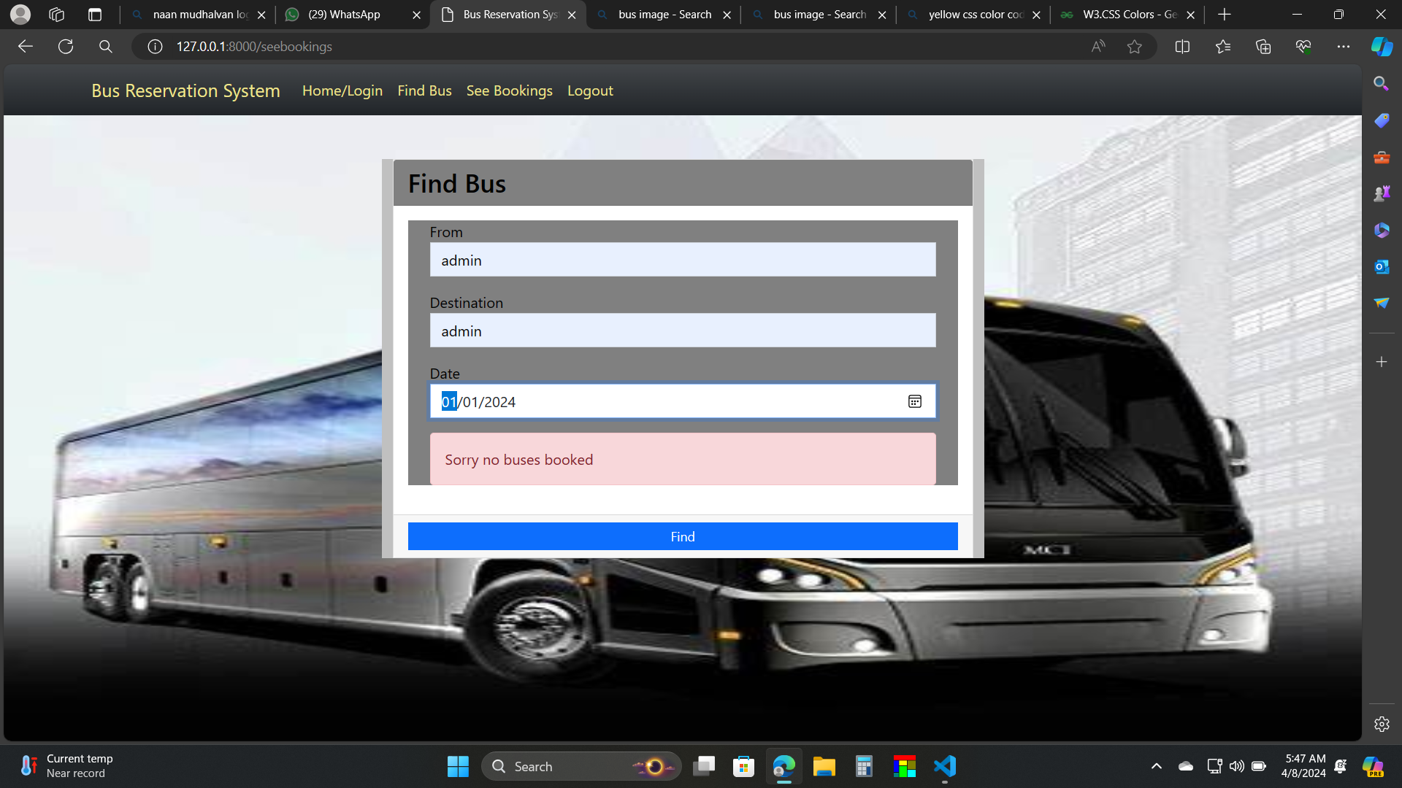
Find bus:

Slide 14
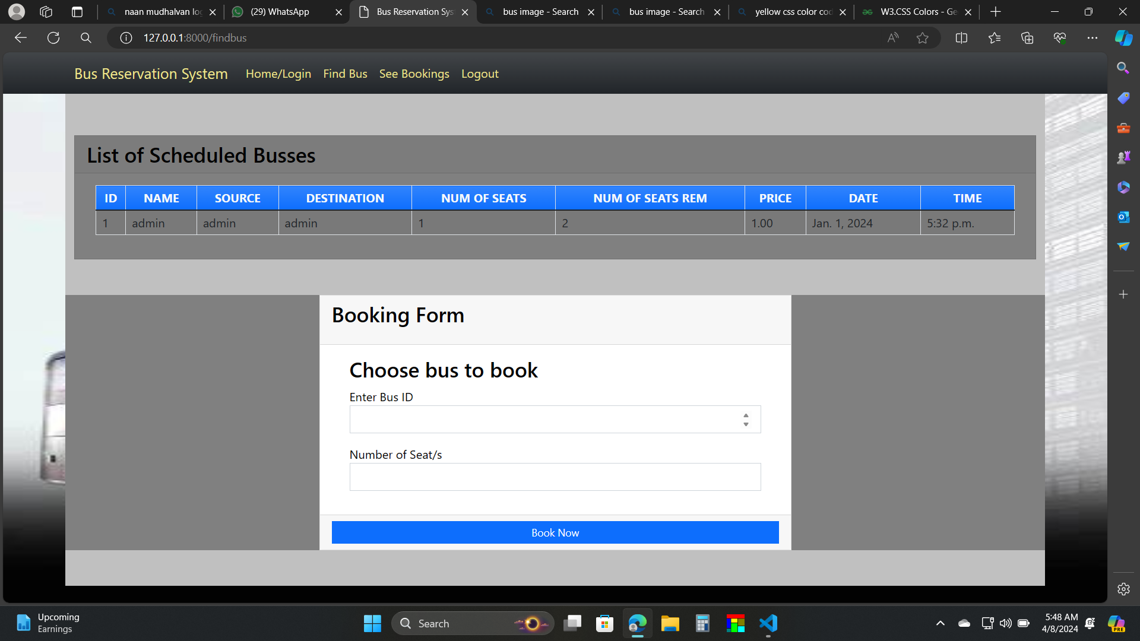
Choose bus:

Slide 15
Booking conformed:

Slide 16
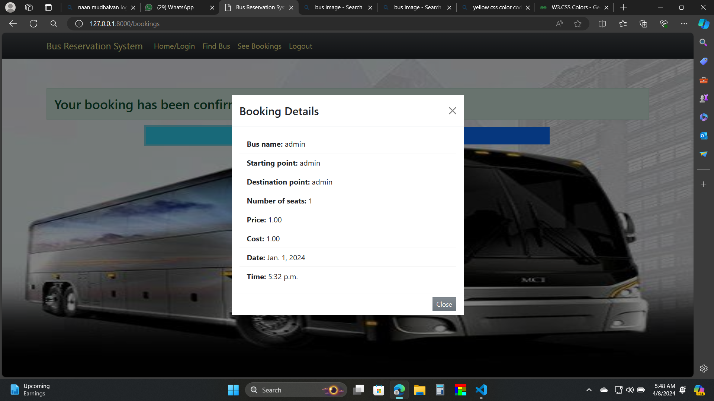
Booked bus details:

Slide 17
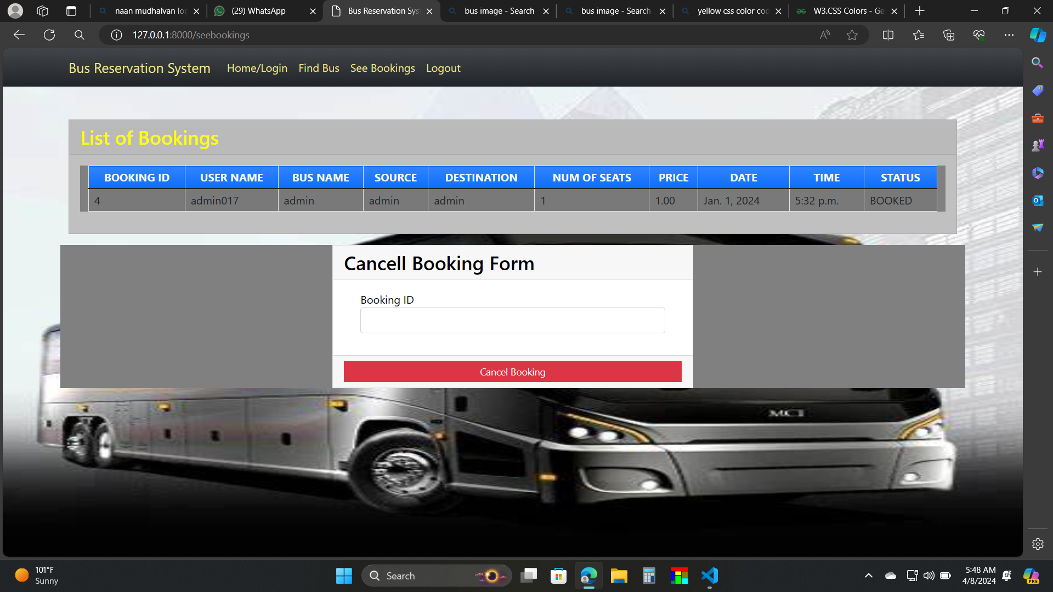
List of booking and cancel form:

Slide 18
Bus cancel confirm

Slide 19
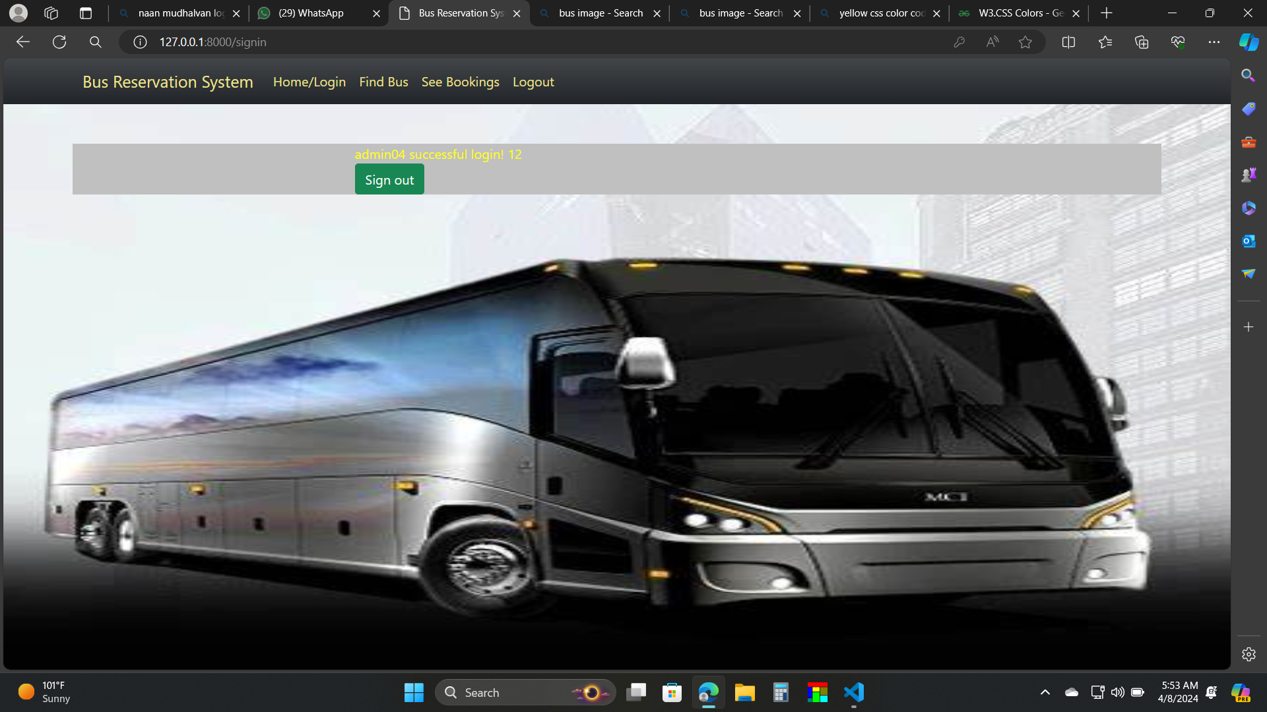
Sign out:

Slide 20
Future Enhancements:
Integration of advanced analytics for demand forecasting and pricing optimization.
Implementation of features such as loyalty programs, discounts, and promotions.
Expansion of the platform to support additional transportation services (e.g., trains, ferries).
Enhancements in user interface design and accessibility features for diverse user groups.
Incorporation of feedback mechanisms to continuously improve the booking experience.
Exploration of emerging technologies such as AI and blockchain for enhanced security and efficiency.
Collaboration with transportation authorities and industry partners to expand service coverage and interoperability.
Continuous updates and maintenance to adapt to changing customer needs and technological advancements

Slide 21
Conclusion
Nowadays, bus agencies are taking important role in transportation, and to make reservation reliable they need a strong system that they will make reservation easier, faster and safer. This project designed to meet requirements of a bus reservation system. It has been developed in XHTML, PHP, CSS, JAVASCRIPT and database has been built in MySQL.
By using this application, the company can provide reservation services and information to their customers without the limitation of office hours or manpower.
Not only does it let customers book trips around the clock from any location with an internet connection but it is also designed for use by the company to internally manage their business processes; minimizing human errors and overcoming difficulties and problems that arose in the previous system
Source :

Slide 22
Thank You!
Notes:
Thank You !!

